Slide 1
STA/BST 222 Survival Analysis Overview
Lihong Qi
Division of Biostatistics
Department of Public Health Sciences
School of Medicine
Oct. 1, 2020

Slide 2
How to contact me
Email is best: lhqi@ucdavis.edu
Phone: 530-754-9234
Office hour: by appointment

Slide 3
How to contact TA
Xiner Zhou
Email: xezhou@ucdavis.edu
Office hours: 7:00pm – 8:00pm, Thursdays
Lab: 6:10-7:00 pm, Thursdays
For both Lab and OH, please use the zoom link with passcode: survival https://ucdstats.zoom.us/j/9681353237?pwd=ZzhLRHlhNG92bHFUaHkwM0Fib1pqQT09 Meeting ID: 968 135 3237

Slide 4
Your turn

Slide 5
About you
Who are you?
Why are you here?
What do you expect?

Slide 6


Slide 7
Outline
Purpose and organization of the course
Introduction
Summary
Homework

Slide 8
Purpose and organization of the course

Slide 9
The Purpose of the Class
This course deals with methods analyzing survival times or time-to-event data, which may be censored and/or truncated.
The main topics are:
estimating a survival curve;
comparing two (or more) survival curves;
regression analysis.

Slide 10
The Purpose of the Class
Recognize the characteristics of survival data, e.g. censoring and truncation.
Determine the proper method to be used in analyzing time-to-event data (e.g., parametric, semi-parametric or non-parametric method).
Understand the assumptions and the theory for the method chosen to analyze the data.
Apply mathematical and graphical methods to check goodness of fit.
Perform survival analysis using a computer statistical software package (SAS), and Interpret computer outputs.
Assess the quality of survival analysis conducted in published research papers.

Slide 11
The Purpose of the Class: a note
This is not a course only on how to run a SAS program and interpret its output.
You also need to know underlying statistical procedures, including their modeling assumptions and possibly their derivations.

Slide 12
Course Prerequisites
Best if you have taken STA 231A, B (Mathematical Statistics I, II) or STA200 ABC for MS students, BST223: Generalized Linear Models, or equivalent.
Students are supposed to know concepts of distributions, statistical estimations and hypothesis testing; linear regression, generalized linear regression (e.g. logistic regressions), maximum likelihood theory, and to have some experiences in using SAS and R.

Slide 13
Course Text and Readings:
Required: J.P. Klein and M.L. Moeschberger, Survival Analysis, 2nd edition. Springer, 2003. (KM)
Optional:
P.O Allison, Survival Analysis using the SAS System. SAS Institute Inc. 2010
Applied Survival Analysis Using R, Dirk F. Moore, Springer.
John D. Kalbfleisch and Ross L. Prentice. The Statistical Analysis of Failure Time Data, 2nd Edition. Wiley-Interscience, 2002.
David G. Kleinbaum and Mitchel Klein. Survival Analysis: A Self-Learning Text, Third Edition. Springer, 2011.
Software: SAS (for data analysis) and R (for simulation)

Slide 14
Methods of Instruction and Work Expectations
Online lectures are the main method of instruction. Students are expected to:
attend online class (5%) and participate in discussions (+10%)
read the textbook and finish assignments (25%)
complete projects 1&2 (50%)
complete midterm and final summary reports. (10%)
Zoom attendance is mandatory. Requests for exceptions must be made to the instructor at least 3 days prior to the expected absence, or as soon as possible in the case of an emergency.

Slide 15
Methods of Instruction and Work Expectations
Late assignment is not accepted unless with in advance permission from the instructor (see below) or with other legitimate reasons (such as illness).
Your UCD e-mail address is regarded as your official e-mail address. Updates, class information, assignments, and all other correspondence will be sent to your official UCD e-mail address.

Slide 16
Evaluation and Grading
Course evaluation will be based on course participation, homework assignments, project 1 and project 2, midterm and final summary reports, with weights 15%, 25%, 25% and 25%, 5% and 5% respectively.
Course Participation: Online discussions and webinars. If a student actively participates all online discussions and webinars, the student will get 15% of the final grade for participations (5% for attending but not actively participate discussions. Scales will be used to evaluate the level of participations.)
10-15 minutes review through group discussions
Group discussions. Fixed or random?

Slide 17
Evaluation and Grading: homework
Homework assignments: involve some theoretical problems and running SAS or R programs to analyze data. Please note that it is required to include your SAS or R programs, only relevant parts of output, major steps of hand calculations, and necessary interpretations/conclusions.
Students are allowed to discuss homework problems, however, each one is expected to program and write up independently. Copying other's work, including computer programs, is cheating or plagiarism, which will lead to an automatic "F" and possible reporting to the University office.

Slide 18
Evaluation and Grading: project 1
Project 1 (25%) will include the following tasks:
Identify a dataset
Specify the hypothesis
Define event and time and censoring/truncation mechanism
Propose appropriate survival analysis and then perform the analysis to analyze the data
Writing a final report using the Publication Manual of the American Psychological Association format (https://apastyle.apa.org/)
Include software codes in Appendix.

Slide 19
Evaluation and Grading: project 1
Report:
In the method section, describe in detail the primary analysis methods used, including assumptions, and theoretical derivation.
In the result section, include interpretations of your results
Students need to submit a milestone report during the 6th week, first week of November.
Students CANNOT collaborate on the project

Slide 20
Evaluation and Grading: project 2
Project 2 (25%) will include the following tasks:
Identify a medical paper published in journals such as JAMA, JAMA Oncol, Cancer, Clinical Trials, Cancer Epidemiol Biomarkers Prev, Journal of the Academy of Nutrition and Dietetics, American Journal of Epidemiology, American Journal of Public Health.
Understand event and time and censoring/truncation mechanism in the paper and the primary hypothesis of the paper
Simulate the data using the values presented in the paper
Analyze the simulated data using various methods you have learned and explain why you choose these methods.

Slide 21
Evaluation and Grading: project 2
Derive formulas for the primary analysis method including assumptions.
Re-generate major results reported in the paper, including tables and figures.
Write a report using Statistics in Medicine format (https://onlinelibrary.wiley.com/page/journal/10970258/homepage/la_tex_class_file.htm) for Project 2
Include software codes in Appendix.
Students CANNOT collaborate on the project

Slide 22
Evaluation and Grading: notes
Presentation: choose one project for a 10 minutes presentation.
Both projects will be due on 12/12/2020.
More specific details about the projects will be given in future classes.

Slide 23
Evaluation and Grading: summary reports
Midterm summary report (5%): review and summarize useful things you have learned so far and how you plan to apply them. Due by November 2, 2020
Final summary report (5%): review and summarize useful things you have learned in this course and how you have applied them and/or plan to apply them in your future research or career. Due by December 12, 2020

Slide 24


Slide 25
Introduction
What is survival analysis
Why survival analysis
Censoring data

Slide 26
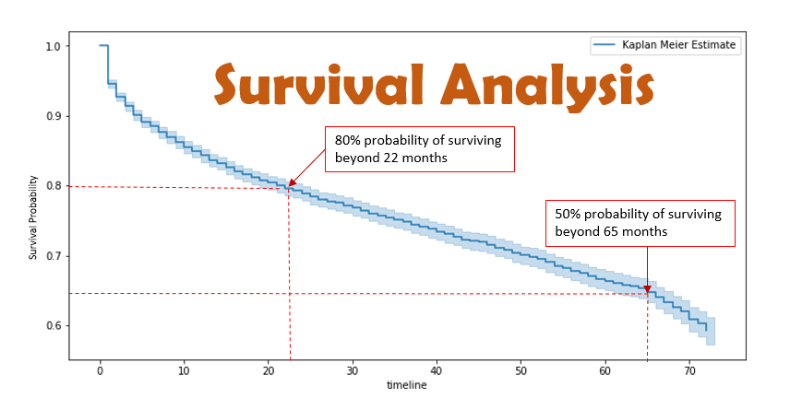
What’s survival analysis?
Survival analysis is a collection of statistical procedures for analyzing survival data.
https://towardsdatascience.com/survival-analysis-intuition-implementation-in-python-504fde4fcf8e

Slide 27
What’s survival analysis?
Nonparametric
Kaplan-Meier estimator (1958)
Log-rank and Wilcoxon tests
Semi-parametric
Cox proportional hazards regression (1972)
Parametric
Accelerated failure time models

Slide 28
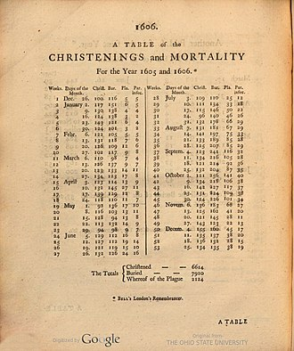
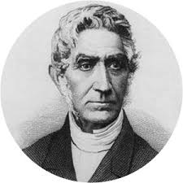
What’s survival analysis?
The development of survival analysis dates back to the 17th century with the first life table ever produced by John Graunt, in 1662. He was probably the first demographers and epidemiologist.
https://en.wikipedia.org/wiki/John_Graunt

Slide 29
Why survival analysis?
Data are survival data (i.e. time to event).
Interested in the risk over time (trend), not just at one time point.
Picture of health and disease over time is important in Epidemiology and Public Health
Explanatory (independent) variables explain the differences in time to an event.
Most important point: survival analysis can handle participants with no event, i.e. censoring.

Slide 30
Why survival analysis?
“Today scientists are using it for time until onset of disease, time until stock market crash, time until equipment failure, time until earthquake, and so on. Common events studied are death, disease, relapse, and recovery.”
Singh R, Mukhopadhyay K. Survival analysis in clinical trials: Basics and must know areas. Perspect Clin Res. 2011;2(4):145-148. doi:10.4103/2229-3485.86872

Slide 31
What’s survival data?
Survival data consists of an event (binary) and time to the event (continuous).
Event: occurrence of some specific event.
Logistic regression
Time: how long it takes for the event to occur
Linear regression
Survival data is also known as time-to-event data, failure time data, event history data.
Very common in the pharmaceutical field
Most clinical trials produce survival data

Slide 32
What makes survival analysis different?
Censoring
the event is known to occur only in a certain period of time.
Truncation
Only certain subjects are included in the study.
Non-normality
Right skewed data.

Slide 33
Types of censoring
Let T denote failure time and C censoring time
Right censoring
T > C, i.e. min(T,C)=C
Left censoring
T < C, i.e. min(T,C)=T, but T is not observed
Interval censoring
Event time known in an interval

Slide 34
Type I Censoring: pre-specified censoring time
Censoring time is pre-specified.
X: a subject’s life time
C_r: right censoring time, can be constant, e.g. end of study

Slide 35
Progressive Type I censoring
Progressive Type I censoring
Individuals enter the study at the same time but can have different, pre-specified censoring times
Reduce the cost and allow for limited information on the survival experience of longer lived individuals

Slide 36
Generalized Type I censoring
Generalized Type I censoring
Individuals enter the study at different times and censoring times are predetermined.

Slide 37
Generalized Type I censoring: a convenient representation
Shift starting time to 0
Another method: Lexis diagram (Keiding, 1990)
Read on your own.

Slide 38
Homework 1
Reading the textbook KM, Chapter 3.1-3.4
Answer the following questions:
What are the new things you’ve learned, or new understanding of something you knew before?
How would you apply them to your research/project?
Prepare for group discussions in next class.
Reading the textbook KM, Chapter 1, and identify examples for different censoring and truncation mechanisms. Due by next Thursday.
Think about and write down your specific goals for this course, develop a specific and practical plan to achieve your goals. Be specific. Due by next class.

